Slide 1
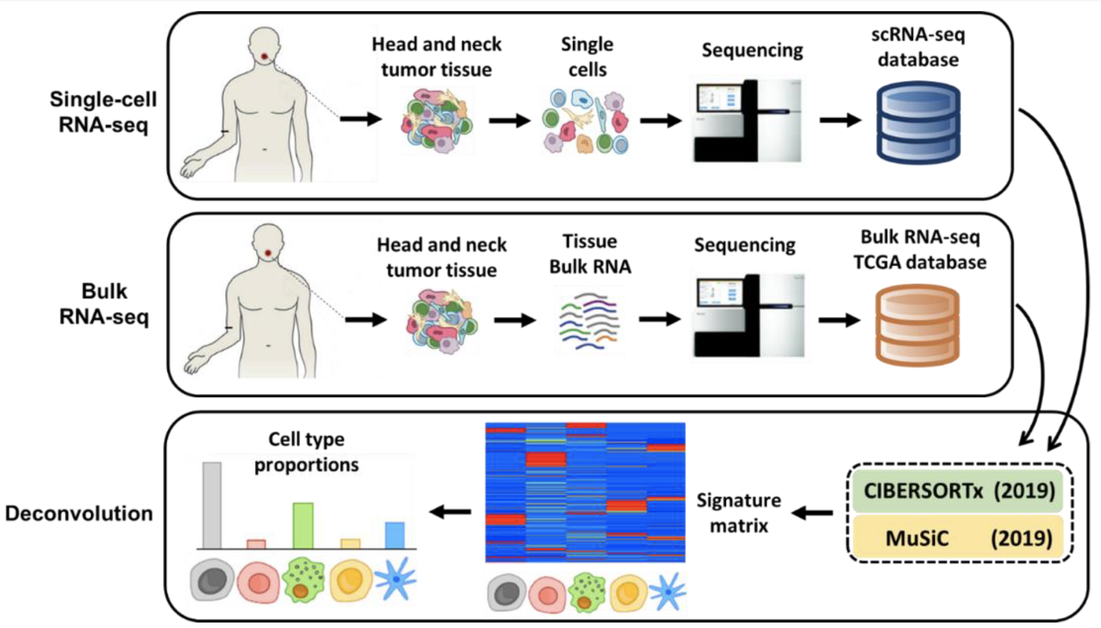
Insights into Breast Cancer from deconvolution of bulk RNA Sequencing Data
Yves Greatti, Reem Shamma, Lingzhy Shen
Foundations of Computational Biology and Bioinformatics Project
Abstract
Methodology
Results
Conclusion
Deconvolution of bulk RNA sequencing data
uncovers heterogeneity in cell-type composition
and subtypes across breast cancer patients,
shedding light on potential molecular mechanisms
of cancer development and progression.
TCGA BRCA read count and clinical data was collected using TCGAbiolinks and TCGAWorkflow.
Deconvolution implemented MuSiC
XGBoost Python package was used to create a regressor model on the immune ESTIMATE score with cell proportions as covariates.
Impact of cell types on immune score were identified with Shapley values.
PROGENy and decouple allow to identify activated cancer pathways.
Survival analysis were performed:
Kaplan-Meier survival analysis with log-rank test
Hazard ratios from Cox proportional hazards regression models
Add your information, graphs, and images to this section.
Add your information, graphs, and images to this section.
Breast
tumor tissue
Breast
tumor tissue
Introduction
Bulk RNA sequencing cannot distinguish between different cell types or states, but single-cell RNA sequencing (scRNA-seq) can identify and profile the transcriptome of individual cells.
Cancer cells produce cytokines and chemokines that attract immune cells to the tumor microenvironment (TME)Tumor-infiltrating immune cells may physically destroy tumor cells, improving clinical prognosis, but persistent activation of the immune system can lead to chronic inflammation, promoting tumor growth.
Recent studies show that accounting for the heterogeneity of immune cell infiltration can result in more accurate tumor subtype predictions and survival analyses.
Breast cancer (BRCA) is highly variable in prognosis, and the TME's heterogeneity can significantly impact patient outcomes
Using two scRNA-seq GEO datasets GSE176078 and GSE161529, two studies related to the cell composition within breast tumor, we deconvolute TCGA BRCA cohort to obtain the cell type proportions of 113 normal and 1,111 cancer patients.
We identify the cells present within the TME of breast cancer: immune cells (monocytes, T-cells), myeloid cells (macrophages, monocytes), hormone sensing, basal, alveolar, fibroblast and vascular and lymphatic cells.
We build and fine-tune a decision-tree regression model to predict the ESTIMATE-immune score of the TCGA cohort from the cell type composition, and reveal the major cell type contributors of the immune response
From the cell proportions, we analyze the different cancer pathways underregulated or overregulated.
We assess the impact of specific cell types on the overall survival (OS) and disease-free survival (DFS) of cancer patients.
Acknowledgements
Add your information, graphs, and images to this section.

